Slide 1
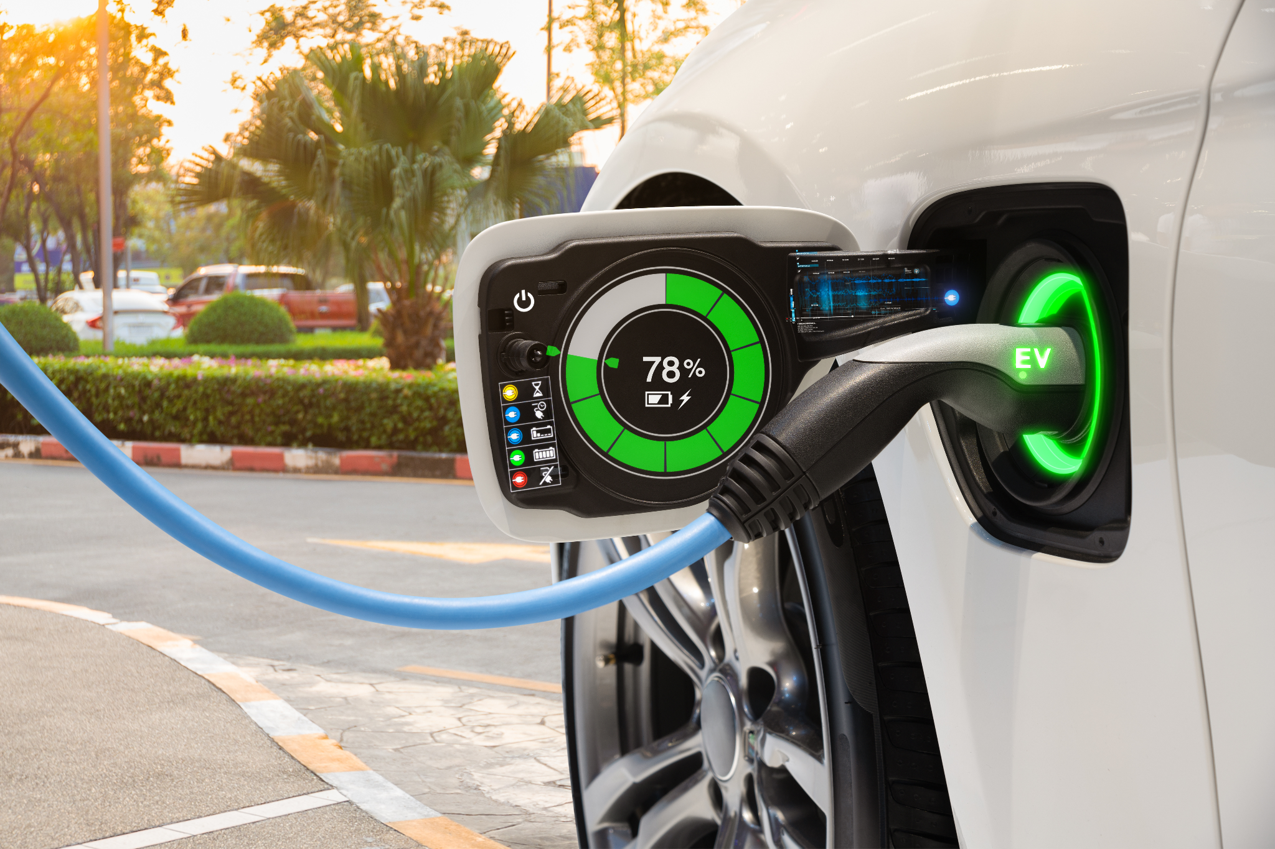
Geometricks
A comprehensive view of EV sales in the state of California

Slide 2
What factors contribute to sales in CA?
The purpose of this project is to analyze factors that contribute to EV purchases in the state of California. At a more granular level, we will be looking at factors within California counties to determine any relevant factors that contribute most to purchases.
With this analysis we would like to answer the following questions:
What is the opportunity in identifying a gap in this dataset?
What is the market opportunity?
Which counties in CA should EV manufacturers focus their marketing?
Should EV manufacturers be encouraging implementation of incentives to drive sales?

Slide 3

Localizing trends in Global Market: What’s driving up EV sales
Global Trends
US markets Impacts
01.
EU growth (2019 – 2020) > US & everywhere else
West Coast EV uptake 2.7x more than national average
02.
Infrastructure investments ramping up in EU
Infrastructure investments & incentives to purchase EVs in planned via US Govt.
03.
Policy pressures – EU reduction in emissions and vehicles in cities
OEM strategies - model availability, production, sales targets
Policy pressures - CA, WA, CO ICE bans are coming.
04.
Corporate influence - EV company cars, values driven priorities impacting EV market
OEM: more models available, aggressive production and sales targets across
05.
06.
Consumer sentiment - price point, driving range, charging are key to adoption
Consumer sentiment - price point & driving range close to ICE
Notes:
State / By Year / Details
ICE Bans:
Washington / 2030 / All new vehicles sold must be zero emission
California / 2035 / All new vehicles sold must be zero emission
Colorado / 2050 / All new vehicles sold must be zero emission

Slide 4
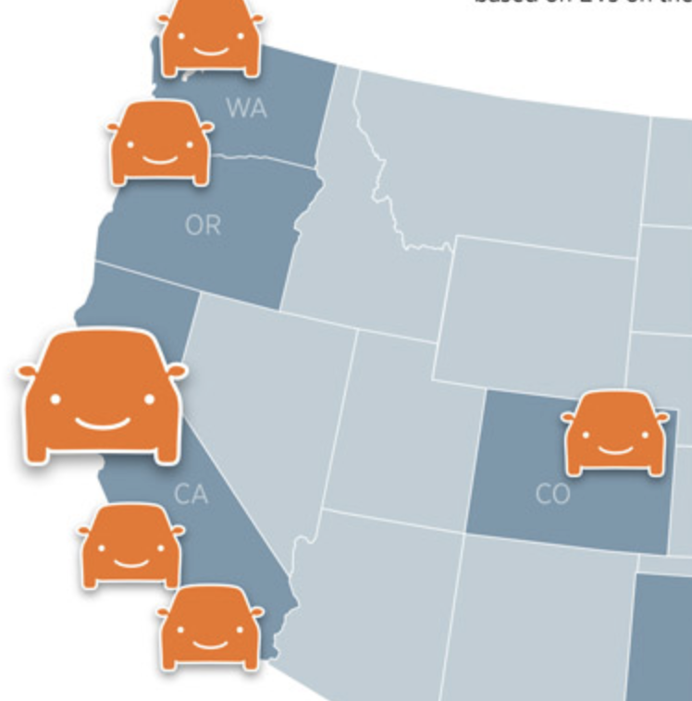
West Coast EV Adoption
Largest EV markets
West Coast EV adoption rates ~3x nat’l average
Southern California
Northern California
Seattle
Portland
EV adoption is set to grow
Many states are phasing out ICE vehicles
Investments in infrastructure and EV consumer incentives are growing
Price point and driving range are on par with ICE
Tire and service needs are poised to grow exponentially
*Internal Combustion Engine
Notes:
Just another reason West Coast is the Best Coast

Slide 5
Data Exploration
Identified topic to help guide the process of data exploration
Dug further into the topic and identified certain factors that potentially could tell/support our story.
Each of the group members took a set of data and owned that dataset.
We each then reviewed each of the data points and identified data points that were not necessary.
In addition, we identified any data points that needed to be converted or re-shaped.

Slide 6
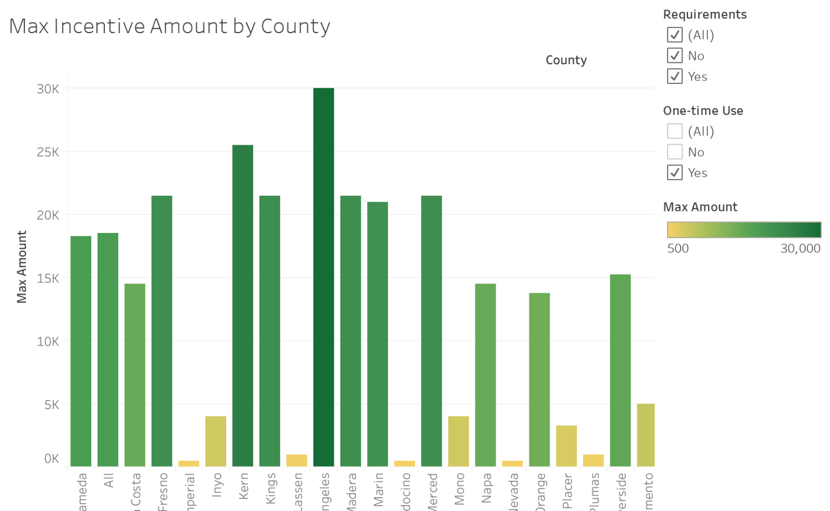
Incentives by Counties
The following bar graph illustrates the max incentives broken down by county in the state of California.
By far we can see Los Angeles county tops the chart offering up to 30K in total incentives*.
*Certain incentives require meeting several requirements in order to be eligible.

Slide 7
Demographic makeup

Slide 8
Conclusions

